Slide 1
Creating the Contact Manager
Team 11

Slide 2
Members (7)
HUONG DANG
JACQUELYN LAW
JESSICA MORENO
TIMOTHY RIGBY
RACHAEL SERA
Krystal Siler
LORRAINE YERGER

Slide 3
About the Project
Contact manager that allows users to add, view, delete, and search contacts
LAMP stack
Linux Apache MySql PHP
Hosted on GoDaddy
Developed in WAMP server on local Windows/Mac machines
GitHub source control
Notes:
Lorraine

Slide 4
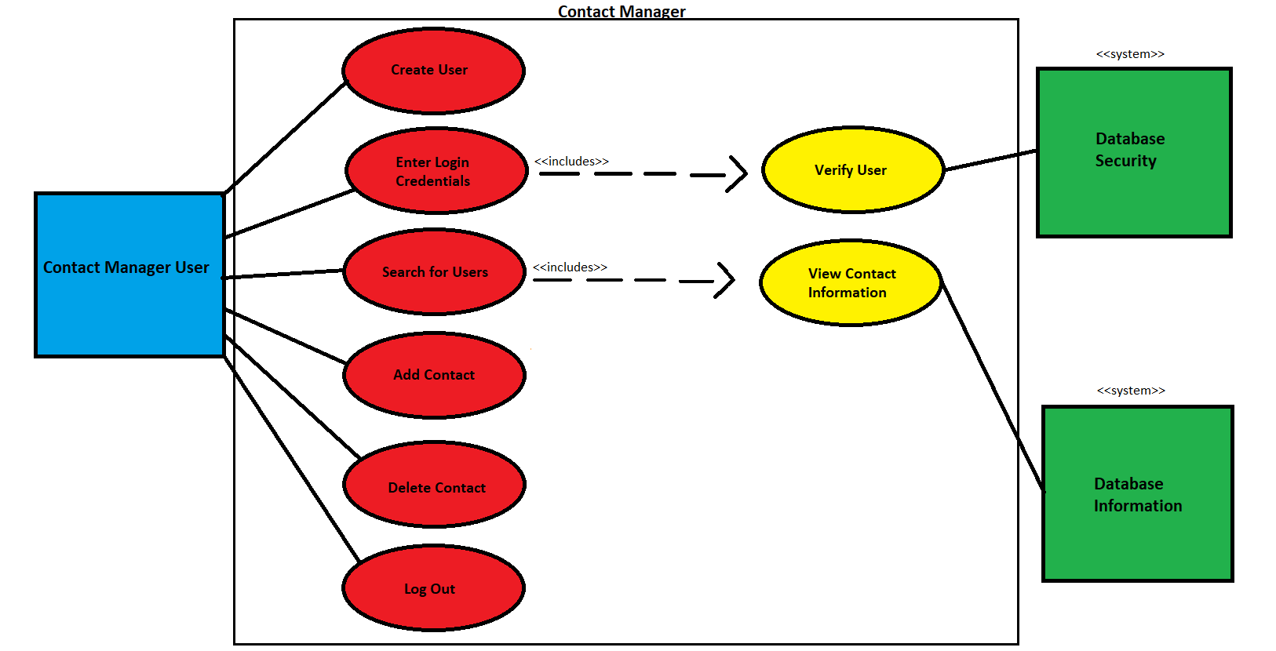
UML Use Case Diagram
Notes:
Tim

Slide 5
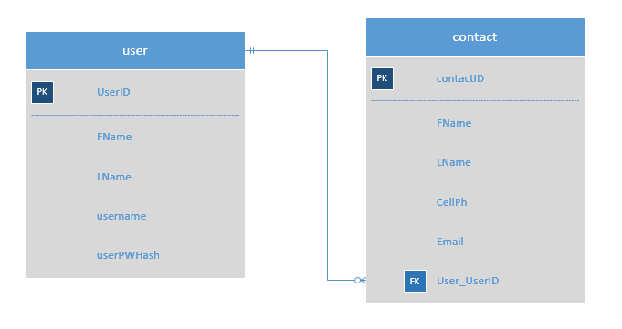
ER Diagram
Notes:
Jessica

Slide 6
The Development Process: Workflow
Work was loosely divided into categories
frontend, backend, API (front and back), and database
Frontend/UIUX dictates the structure of the page with HTML. Designs the page with CSS and Bootstrap.
Frontend API utilizes the IDs and classes from that HTML template to create JavaScript file (using JQuery and AJAX) to asynchronously perform actions and update the page.
Notes:
Krystal

Slide 7
The Development Process: Workflow
Backend API receives requests from frontend API and returns data in JSON format using AJAX and JQUERY in PHP files.
Backend establishes connection to the database, creates sessions, manages login, and dynamically generates HTML in PHP files.
MySQL database holds information for all users and contacts in tables. It is accessed by the backend and backend API
Notes:
Huong

Slide 8
Challenges
No one had built an ajax-enabled website with a database before!
New technologies
All the different pieces of code are interdependent, so modifying one piece can break another
Required lots of communication
This is why documentation and planning is useful
Large group
Making sure everyone has a voice
Notes:
Jackie

Slide 9
Demonstration
aptimage.net
Notes:
Rachael

Slide 10
Questions?

